Slide 1
Intro To: Audio Synthesis For Music
Alan Wolfe
http://Blog.demofox.org

Slide 2
Goals & Intro
Get an intuitive sense of audio synthesis for music
Be able to experiment immediately and get results
Caveat: I am a programmer by trade, not a musician –OR– a sound designer!
I’m using a qwerty keyboard for demos, but MIDI devices are pretty easy to interface with too!
Music/Audio/Synth is very much “whatever works”
More Audio Synth topics on my blog: blog.demofox.org

Slide 3
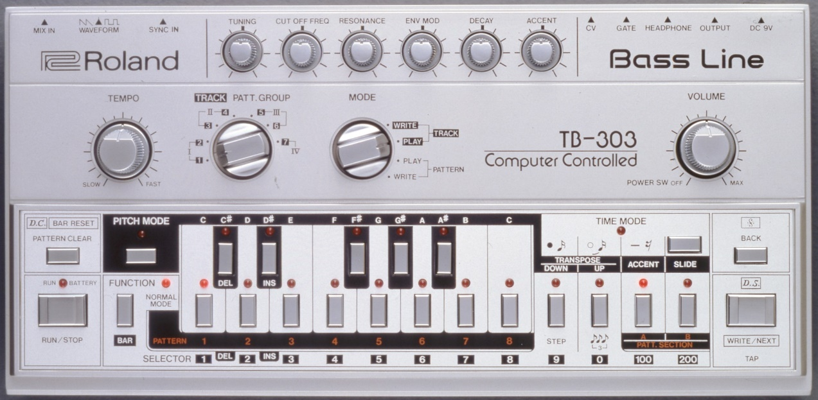
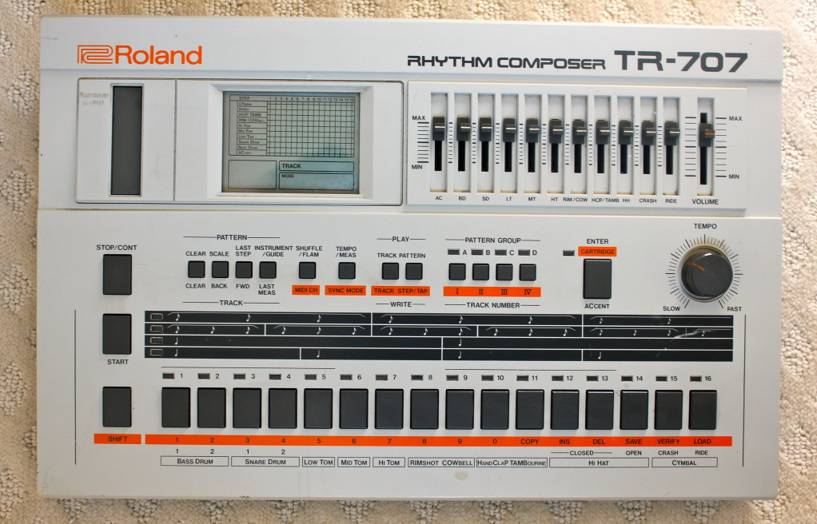
Roland 303 Synth & 707 Drum Machine
1982
1984
https://www.youtube.com/watch?v=McFMCh8CFag&t=170

Slide 4
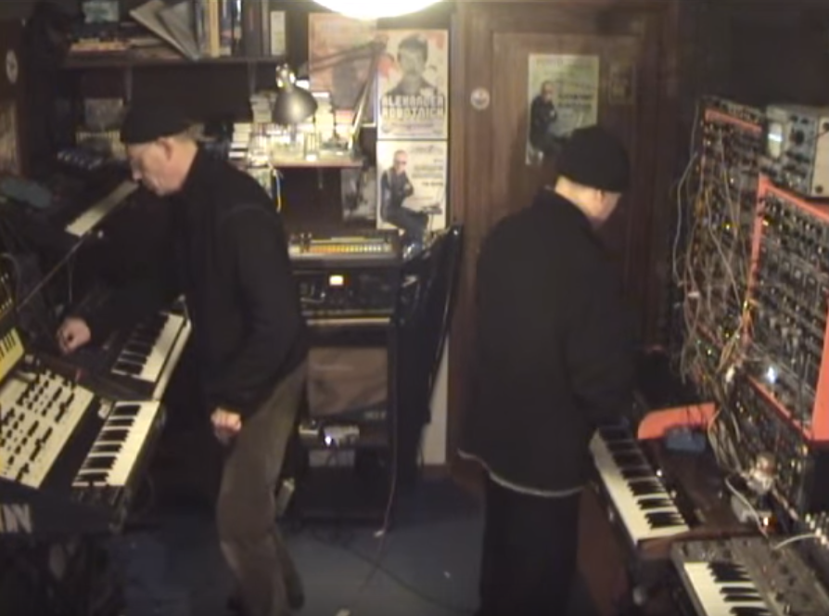
Modular Synth
https://www.youtube.com/watch?v=H511Iye6BsI&t=40

Slide 5
What Is Audio Data?
A stream of numbers between -1.0 and 1.0 (usually)
Changes in values important, not values themselves
Value dictates speaker location over time
Better speakers able to move more quickly and accurately
.wav file literally = header, then samples
Resolution:
X axis = sample rate (audio samples per second)
Y axis = bit depth (size of floating point numbers)
Interleaved data for each channel
EVERYTHING is made from sine waves added together (DSP)

Slide 6
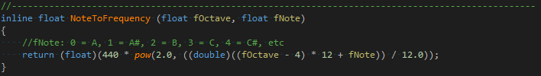
What Is A Note?
A note is just a frequency. Non linear: freq=440*2^{(note/12)}
An octave is a range of 12 notes.
Double a note frequency to go up an octave.
Relative notes matter, not absolute.
Demo: Sine

Slide 7
Popping
Popping = discontinuity in data. Usually unwanted.
Solutions:
Free Spinning Oscillator
Volume Envelopes (more info later)
Free Spinning Oscillator:
NO: output = sine(time*frequency*2*pi);
YES: output = sine(phase); phase += (frequency*2*pi)/sampleRate;
Demo: Popping

Slide 8

Clipping
Clipping = going outside of [-1,1]. Usually unwanted.
A Form of Distortion
sine waves clamp, changing sound (frequencies)
Mostly sounds very bad!
Sometimes sounds very good! (guitar)
Demo: Clipping

Slide 9
Mixing Multiple Sounds
Just add sample values together!
Can cause clipping
Often, peaks and valleys cancel out
Still a problem to watch out for
Automated volume adjustments can help (more info later)
Terminology: Polyphonic synthesizer
Can play multiple notes at once!
Demo: Mixing

Slide 10

Envelopes
Volume changes over time
Can solve popping at beginning and end of sounds
Can also make things (eg. sine waves) very different!
Minimal
Bell
Reverse Bell
Flute
Demo: Envelopes

Slide 11




Common Wave Forms
Sine:
Square:
Saw:
Triangle:
Demo: WaveForms

Slide 12
Aliasing
Another form of distortion (harshness / hurts ears)
Terminology: Nyquist Frequency
If you have N samples per second, limited to freq. N/2.
Going above that causes aliasing.
All sound made up of adding sound waves together
Perfect corners = infinite sine waves at infinite frequencies.
Terminology: Band Limited Signal
Limiting signal to a window of frequencies.
Yes, aliasing is same term and meaning from graphics!

Slide 13



Band Limited Wave Forms
Sine: 1 frequency
Square: All harmonics
Saw: Odd harmonics
Triangle: Odd harmonics
Terminology: Harmonic
Integer multiples of a frequency
Demo: BLWaveForms

Slide 14
Additive Synthesis
Add sine waves together to make interesting sounds
Can analyze sounds in real life and mimic them with limited success (most real sounds are very complex)
Or, just play around until you have something interesting.
Demo:
10 harmonics
Envelope: 0% quiet, 5% full loud, 10% half loud, 100% quite
Each harmonic envelope lasts: 1.5s / (index)
Lower frequencies last longer, like real life sounds.
Demo: Additive

Slide 15
Tremolo & Vibrato Effects
Terminology: Low Frequency Oscillator (LFO)
A low frequency wave (usually sine wave), commonly used to drive other effects or behaviors.
Very cool and powerful technique!
Tremolo = use an LFO to control amplitude & volume over time
Vibrato = use an LFO to control frequency over time
When LFO Taken To Audible Frequencies (HFO?)
Tremolo = Amplitude Modulation (AM) Synthesis
Vibrato = Frequency Modulation (FM) synthesis
Demo: TremVib

Slide 16
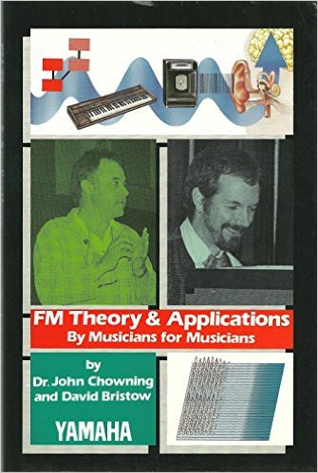
FM Synthesis
Bring Vibrato frequency up to audible frequencies
Very hit or miss black magic, but based on solid math.
2 Parameters:
Frequency of frequency altering wave (frequency)
How much the frequency should be altered by (amplitude)
Can use trees of FM to create complex sounds.
Very Deep Topic!
Yes, related to FM radio a bit.
Demo: FMSynth

Slide 17

Delay (Echo) Effect
Circular buffer of audio samples.
Parameters:
Time: determines size of buffer.
bufferSize = delayTime * sampleRate * numChannels
Feedback: before writing (adding) a new sample into the circular buffer, multiply the existing sample by this value.
How it Works:
ret = buffer[index] + inputSample;
Buffer[index] = buffer[index] * feedback + inputSample;
Index = (index+1) % bufferSize;
return ret;
Demo: Delay

Slide 18
Multitap Reverberation Effect
Reverb = many echos at different volumes and times, from a real environment. Hallways, caverns, churches, small rooms, etc.
Correct Reverb = Convolution of impulse (single 1.0 sample, or a clap) in said environment.
Simpler / Cheaper to just do N echoes at various times and amplitudes.
Multitap Reverb = a delay effect with lots of reads into the delay buffer, multiplying each read by a volume scaling value. Approximates convolution! Not as high quality though.
Demo: 7 taps in a 0.662s delay buffer at various volumes.
Demo: Reverb

Slide 19
Flange Effect
Discovered in analog days by putting a finger on a tape to slow it down.
Mix a sound with itself, at a different time. Time delay varies over time.
Implementation: Use a delay buffer, but instead of reading from the write head, offset the read from the write head using an LFO.
Parameters:
Time: determines size of delay buffer
Frequency: how fast the read offset should move between 0 and bufferSize.
Demo: Flange

Slide 20
Synth Drum + Percussion Sounds
You are better off using sound samples!
There are some ways to make it sound passable though.
This demo is not so great, and just scratches the surface.
Drum:
Use sine wave. Envelope = 10ms attack, 10ms hold, 175ms decay.
Make frequency drop over time.
Cymbals:
Shape noise (static) with an envelope.
Demo: Drum

Slide 21
Volume Adjustment Effects (Simplified)
Compressor = Slowly turn down volume if too loud, turn it back up again when it’s quieter.
Limiter = If sound clips, turn down sound instantly to make it not clip. Turn sound up again later when quieter.
Ducking = make something quieter to make something else stand out more.
Several games do the above to fight ear fatigue and to make sounds stand out.
See also battlefield for high dynamic range audio.
In music, it’s common to use “side chain compression” to make a compressor turn down music in response to drum sounds being loud.
Demo: Ducking

Slide 22
Filtering Effects & Subtractive Synthesis
Some filters can change volume of specific frequencies
Low pass filter (LPF) and High pass filter (HPF) as examples
Subtractive Synth = carve away frequencies
Can only cut away what’s there (odd / all harmonics matters now!)
Subtractive synth can make interesting sounds, as well as bandlimited wave forms.
You can also put filter parameters on LFOs for more interesting sound scapes.
More info: read about Biquads
Demo: Filtering

Slide 23
Stereo Effects
Everything has been “mono” til now. 1 channel.
You can do interesting things with multiple channels.
Positional sounds, varying effects per ear, and more.
Positional Sound:
Deep topic, but can be faked by putting left ear volume on sine LFO and right ear volume on cosine LFO.
Ping Pong Delay:
Echoes first to one ear, then the other, then feeds back into first ear.
Demo: Stereo

Slide 24
Musical Audio Synth Cheat Sheet
Synthesis Types:
Additive – add sine waves together
Subtractive – filter away frequencies
FM – modulate frequency by another wave
AM – modulate amplitude by another wave
Wave Forms:
Sine
Saw
Square
Triangle
Bandlimited Forms
Noise
Effects:
Envelopes / Ducking – Adjust volume over time
Tremolo – Adjust volume by LFO
Vibrato – Adjust frequency by LFO
Delay (echo) – Ring buffer
Multitap Reverb – Multiple reads from ring buffer
Flange – Delay ring buffer read offset by LFO
Filtering – Change frequency amplitudes. LFO?
Limiter / Compressor – automatically adjust volume.
Avoid:
Popping – Keep it continuous
Clipping – Stay in [-1,1]
Aliasing – No frequencies too high
Get The C++ Demo Program and start hacking! https://github.com/Atrix256/MusicSynth
More Audio Synth on my blog: http://Blog.demofox.org

